Slide 1
Early Detection of Alzheimer’s disease
Mini Review

Slide 2
Table of Contents
Introduction to Protein
Recent advances in protein design,
shifting from a physical-based function paradigm to one that uses deep learning
Discuss challenges to the design of marketable proteins with controllable properties.

Slide 3
Introduction
Dataset
More than 95% of the studies that focused on EEG-based classification were conducted with fewer than 100 participants.

Slide 4
Introduction
EEG Recording
EEG signal was recorded at 200 Hz
In a 10-min eye-closed resting state
Participants were required to remain awake during the entire recording
Standard 16-channels montage was utilized according to the 10–20 International System.

Slide 5
Introduction
Alzheimer
Patients with MCI and AD generally showed decreased alpha/beta power and increased theta/delta power in a broad range of brain regions such as frontal, temporal, parietal, and occipital areas

Slide 6
Introduction
Alzheimer
stated that 30% of people are misdiagnosed

Slide 7
Introduction
EEG Recording
EEG signal was recorded at 200 Hz
In a 10-min eye-closed resting state
Participants were required to remain awake during the entire recording
Standard 16-channels montage was utilized according to the 10–20 International System.

Slide 8
Introduction
EEG Processing
A wavelet transform reveals important information in a signal’s time–frequency domain through analysis of frequency components.

Slide 9
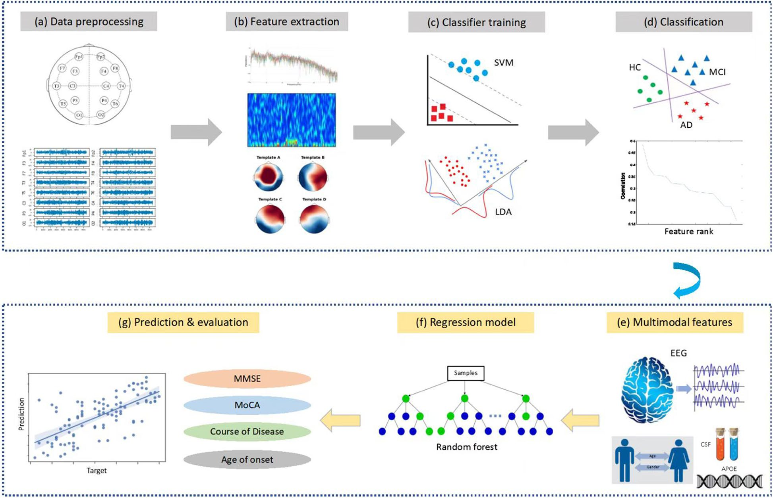
Methods
Overview
Achieved a decent three-level classification accuracy (over 70%)
Datasets are available from the corresponding author upon reasonable request
Jiao B, Li R, Zhou H, Qing K, Liu H, Pan H, et al. Neural biomarker diagnosis and prediction to mild cognitive impairment and Alzheimer’s disease using EEG technology. Alzheimer's Research & Therapy. 2023;15(1):32.

Slide 10
Methods
Overview
A total of 890 participants, including 189 patients with MCI, 330 patients with AD, 125 patients with other dementias and 246
healthy controls (HC) were enrolled

Slide 11
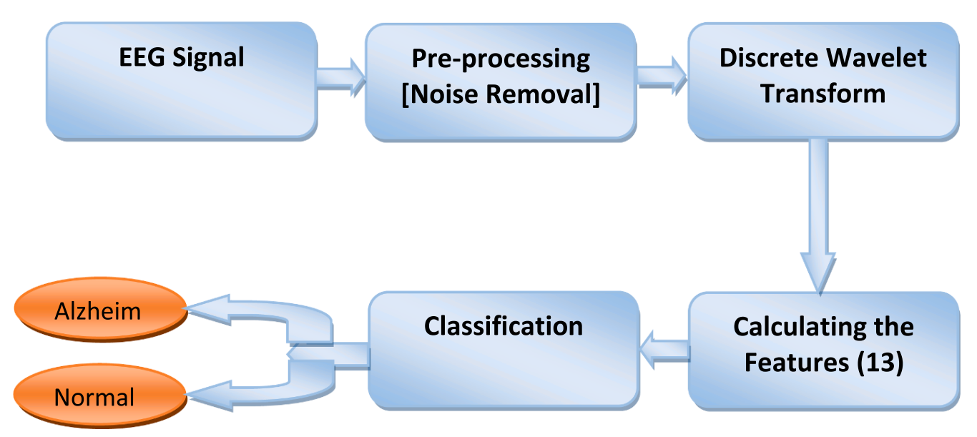
Methods
Fouad, I. A. and F. El-Zahraa M. Labib (2023). "Identification of Alzheimer’s disease from central lobe EEG signals utilizing machine learning and residual neural network." Biomedical Signal Processing and Control 86.

Slide 12
Methods
From a minimum number of electrodes: three central lobe electrodes

Slide 13
Methods
This EEG dataset is available as open source.
The dataset contains 7 MCI, 59 AD, and 102 NC subjects
Highest performance of 96.55%

Slide 14
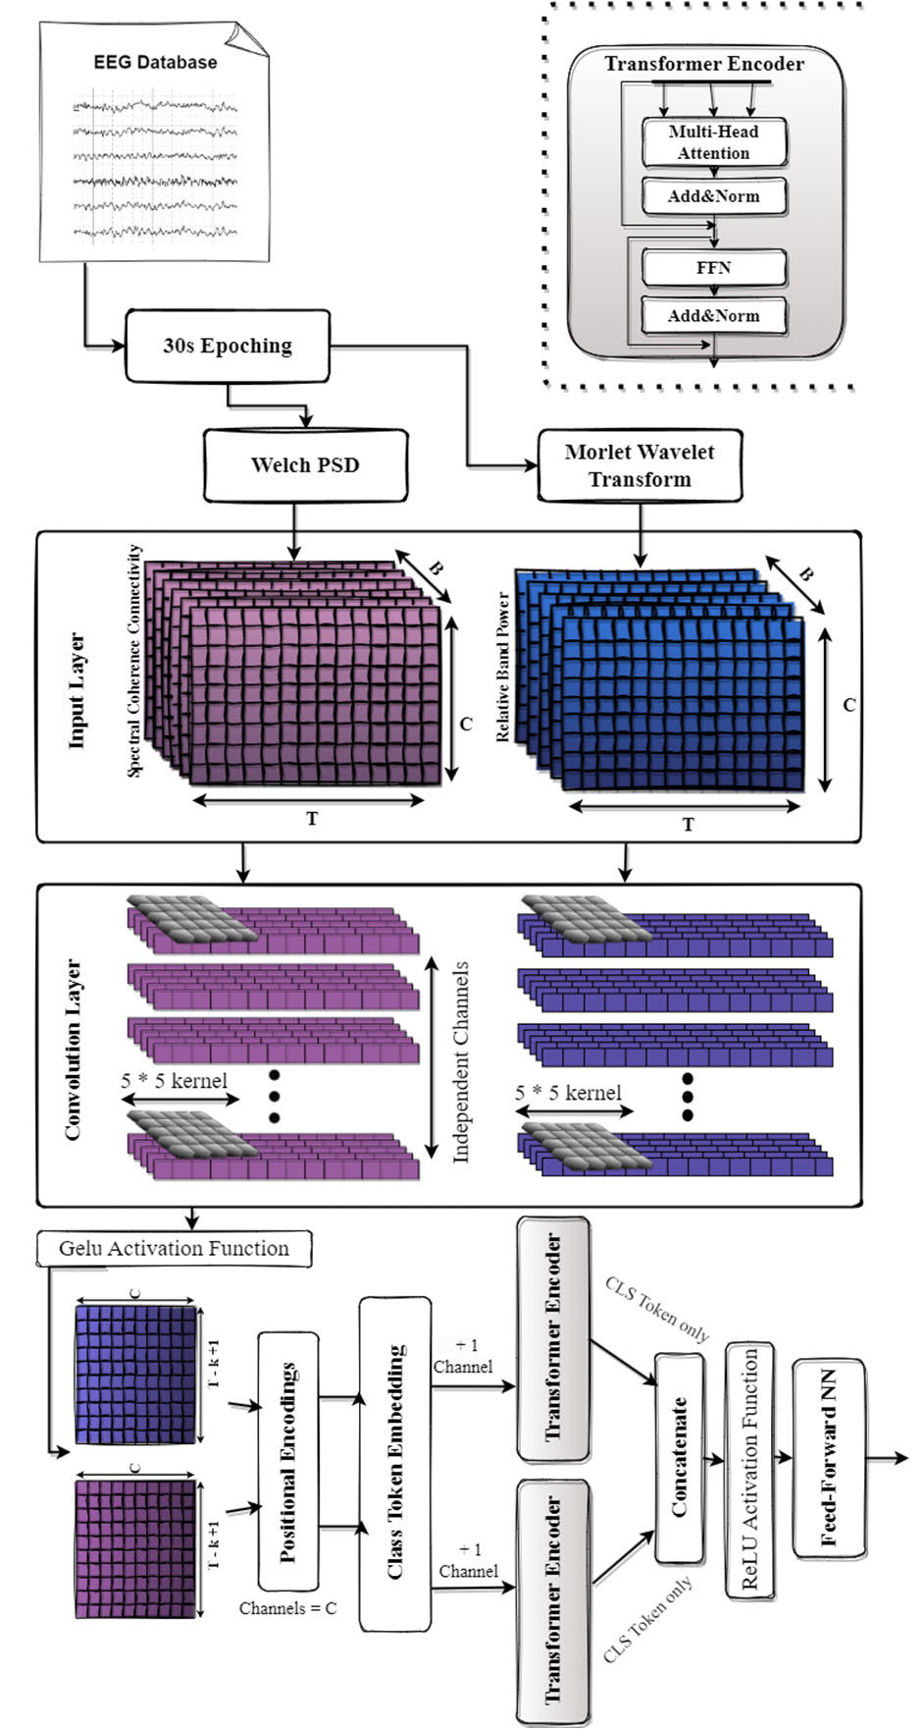
Methods
Miltiadous A, Gionanidis E, Tzimourta KD, Giannakeas N, Tzallas AT. DICE-Net: A Novel Convolution-Transformer Architecture for Alzheimer Detection in EEG Signals. IEEE Access. 2023;11:71840-58.

Slide 15
Methods
classification using a Dual-Input Convolution Encoder Network

Slide 16
Future Works
Evaluate the effectiveness of EEG techniques in diagnosing different types of dementias
Longitudinal studies to assess whether EEG biomarkers can be used to trace the progress trajectory of AD or evaluate the efficacy of pharmacological/therapeutic interventions for AD patients.

Slide 17
References
Molecular Biology, Not Only for Bioinformaticians. Istrail, 2013
From sequence to function through structure: Deep learning for protein design
NoeliaFerruz -2023

Slide 18
Thank You

